Slide 1

This ASHRAE Distinguished Lecturer is brought to you by the
ASHRAE Society Chapter Technology Transfer Committee (CTTC).
Please silence your phones.
DL Evaluation Forms are very important. Please complete at the end of the presentation and return to the CTTC Chair or Program Chair.
Lecturer presentations and/or opinions do not necessarily reflect the policies or position of ASHRAE or the chapter.
More information on the DL Program available at: ashrae.org/distinguishedlecturers

Slide 2
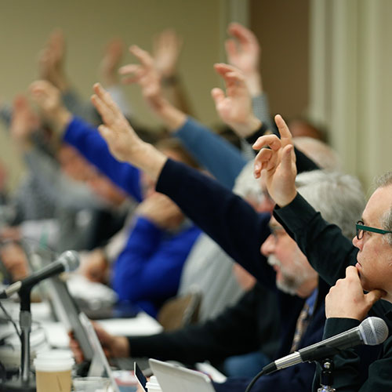
LEADERSHIP WANTED!
Become a future leader in ASHRAE – Write the next chapter in your career!
ASHRAE members who are active at their chapter and society become leaders and bring information and technology back to their job.
You are needed for:
Society Technical Committees
Society Standard Committees
Young Engineers in ASHRAE
Chapter Membership Promotion
Chapter Research Promotion
Chapter Student Activities
Chapter Technology Transfer
Find your place in ASHRAE and volunteer
ashrae.org/volunteer

Slide 3
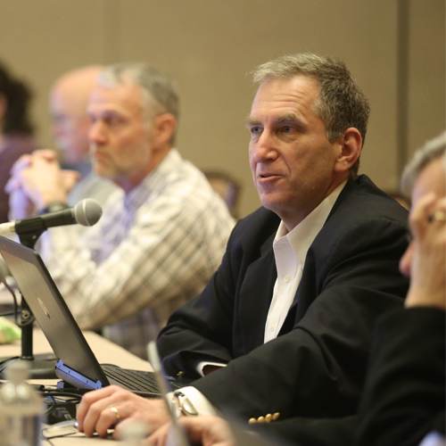
Join a Technical Committee!
Did you like this presentation and its content?
Learn more about this content and become a better professional by joining a technical committee (TC).
If you liked this presentation, join these technical committees:
[You can fill in…
…up to…
…7 lines or bullets…
…of content listing technical committees.
Provide the technical committee number and name
For example,…
TC 5.2 Duct Design
Find your place in ASHRAE and volunteer
ashrae.org/volunteer

Slide 4
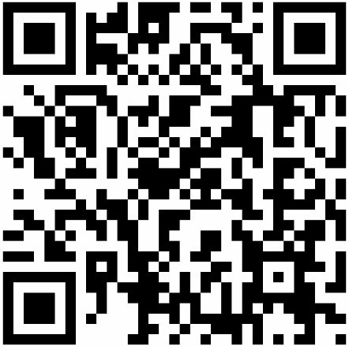
Please complete an evaluation form for today’s DL presentation.
Region | Region #
Chapter | Chapter Name
Meeting Date | mm/dd/yyyy
Lecturer’s Name | Your name
Presentation Title | Presentation title

Slide 5

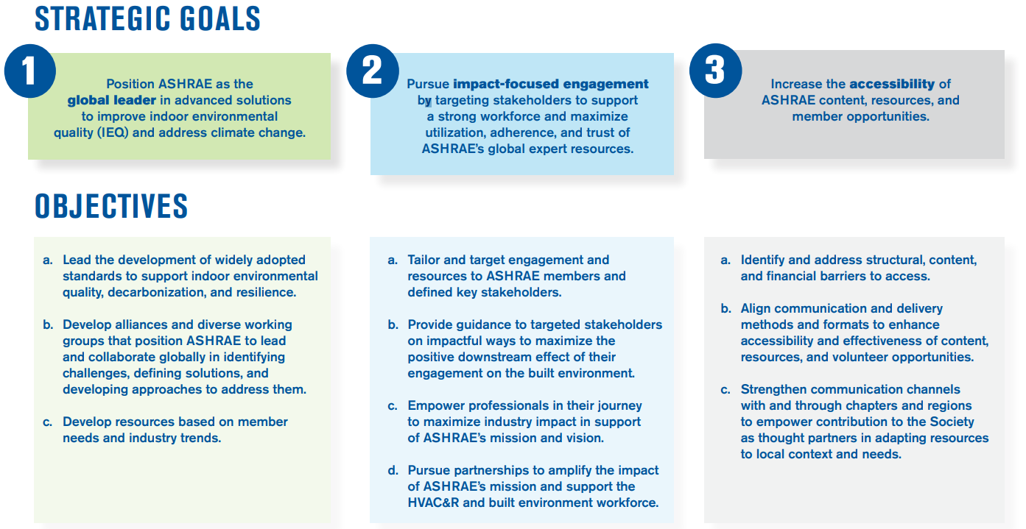
ABOUT
2025-28 ASHRAE Strategic Plan
TECHNICAL RESOURCES
PROFESSIONAL DEVELOPMENT
CONFERENCES
COMMUNITIES
MEMBERSHIP
Notes:
Outcomes
ASHRAE’s member and volunteer base maximizes the organization’s reach, foresight, leadership position, and organizational knowledge.
A broad group of stakeholders leverage ASHRAE's resources to make decisions and meet objectives that positively affect the environment.
A viable, thriving industry makes a positive global impact.
Key Enablers
Research: The value of ASHRAE’s resources is grounded in unbiased data, developed through rigorous research methods.
AI: The use of AI enables ASHRAE to improve data collection, automate internal operations, and promote agility.
Global Network: ASHRAE's global network convenes the industry to generate unparalleled knowledge and content.

Slide 6

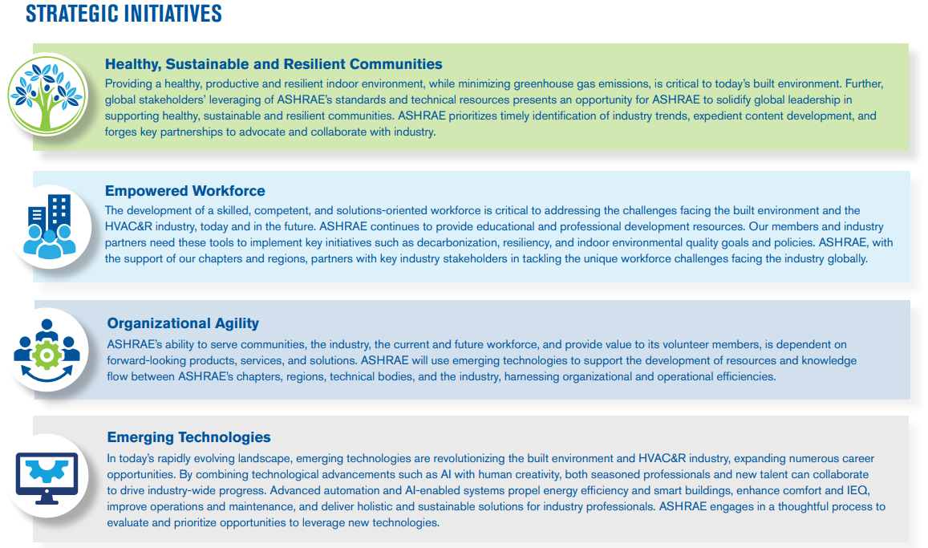
ABOUT
2025-28 ASHRAE Strategic Plan
TECHNICAL RESOURCES
PROFESSIONAL DEVELOPMENT
CONFERENCES
COMMUNITIES
MEMBERSHIP
Notes:
Highlight the following as key events that has informed the final plan
Stakeholder Interviews with ASHRAE members and other industry partners
Survey Questionnaire (distributed to both members and non-members)
BOD facilitated strategy session
The strategic plan identifies key priorities for the society over the next three years. The chapters can use this information to guide their chapter operations so that there is alignment with the society priorities.
For example, EMPOWERED WORKFORCE is a key initiative. Chapters can look to develop programs and training that strengthens the skill sets of the members in their area of operation to expand and or build capacity to serve members and member firms.
Chapter leaders can work with their DRC and regional leadership to identify key initiatives that are specific to their regions/chapters and develop the appropriate tasks so that their chapter operations align with the society’s strategic plan and direction.

Slide 7
ABOUT
2025-28 ASHRAE Strategic Plan
TECHNICAL RESOURCES
PROFESSIONAL DEVELOPMENT
CONFERENCES
COMMUNITIES
MEMBERSHIP
2025-28 Strategic Plan Available for Committees and Councils
The 2025-28 Strategic Plan will be announced to members at the 2025 ASHRAE Annual Conference.
June
Download the Strategic Plan at ashrae.org/strategicplan
Download
Notes:
A few of the many resources in the ‘About’ section of ashrae.org include the Strategic Plan. The Planning Committee and ASHRAE Board of Directors are asking committees and councils to reference this document for planning their 2025-26 MBOs.

